Slide 1
Materials Management Planning Jeff Krcmarik, EGLE Recycling Specialist

Slide 2
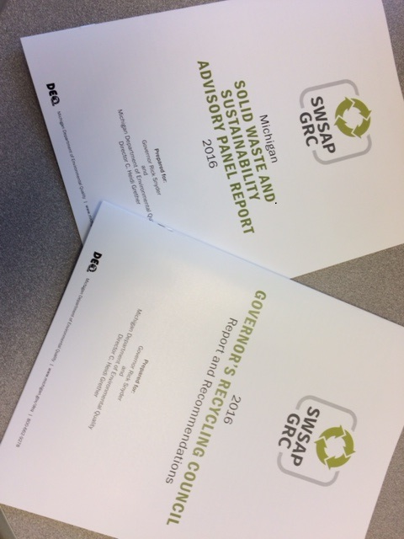
Solid Waste Legislation
Updated Materials Management Planning process
Increased education and awareness of disposal options and techniques
Provide standards for recycling and composting facilities
Update landfill requirements
Notes:
Existing legislation has been focused on developing landfill disposal capacity, perhaps at the expense of more sustainable ways of managing materials like recycling and composting.
The updates have been a herculean task. The latest draft is over 200 pages and will be ready for introduction this year.
High level agreement has been reached on the needed changes and include:
Adding the siting and development of waste utilization facilities, such as recycling facilities, to the local planning process
Enhancing the importance of local zoning for siting and developing waste utilization facilities
Requiring counties to meet benchmark recycling standards and include measurable recycling goals and objectives
Incorporating ways to increase recycling access and participation
Specifying local funding mechanisms that can be used to support recycling
Enabling municipalities and counties to require haulers to provide recycling services
Eliminating restrictions on the flow of waste materials among the counties.
Reducing risk to taxpayers by requiring more financial assurance for facilities
Providing a means to authorize research and innovative projects outside of the traditional permit model
Establishing custodial care provisions for landfills that have completed post closure, and allow the DEQ to reduce or extend post closure requirements as appropriate
Developing standards of oversight for recycling facilities that ensure a level playing field with landfills and are not overly burdensome for something we want to promote.
OVERARCHING POINT: Introduce the MMP concept and say that we will, for the purposes of this presentation, be shifting focus to discuss the MMP process.

Slide 3
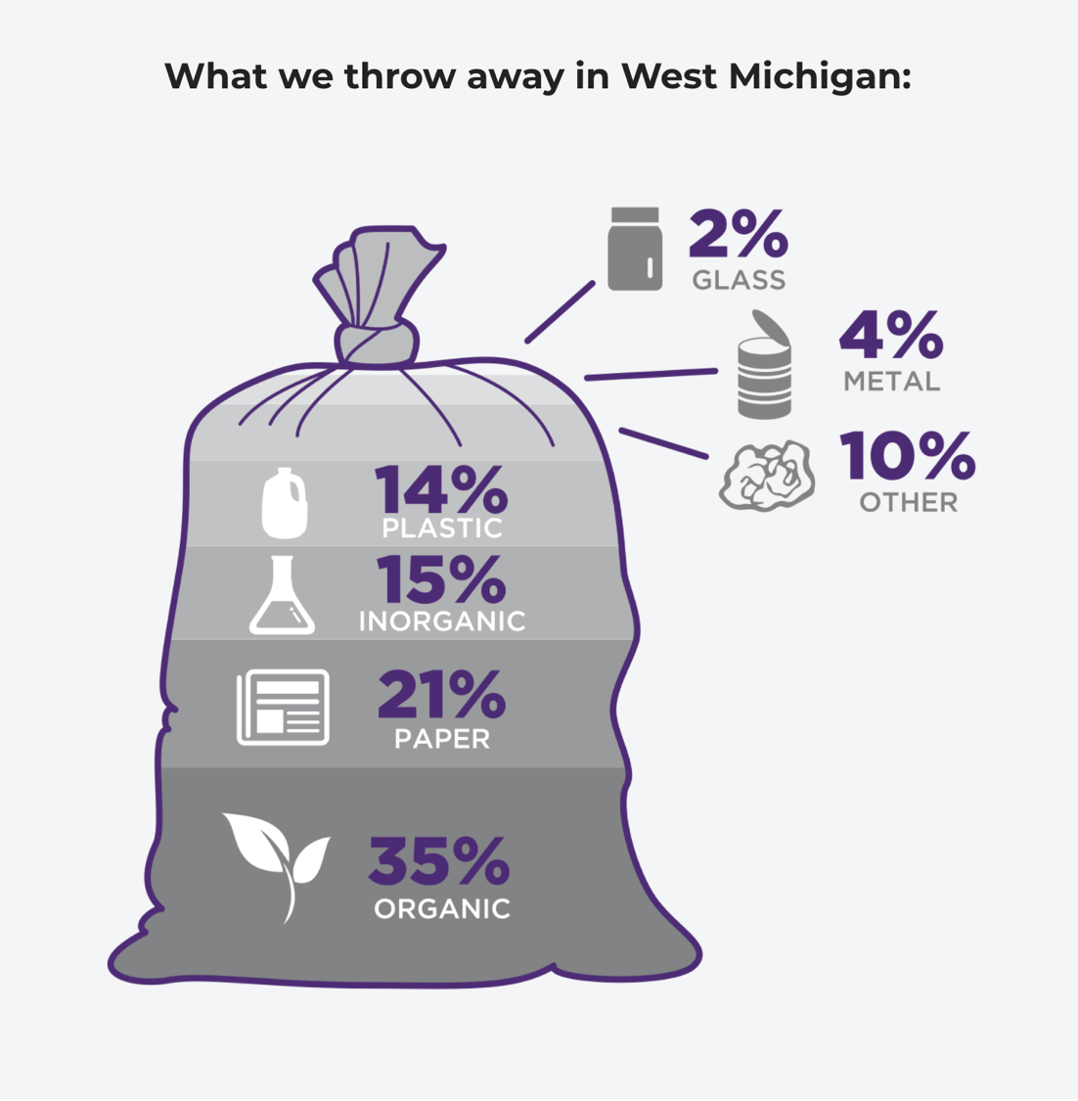
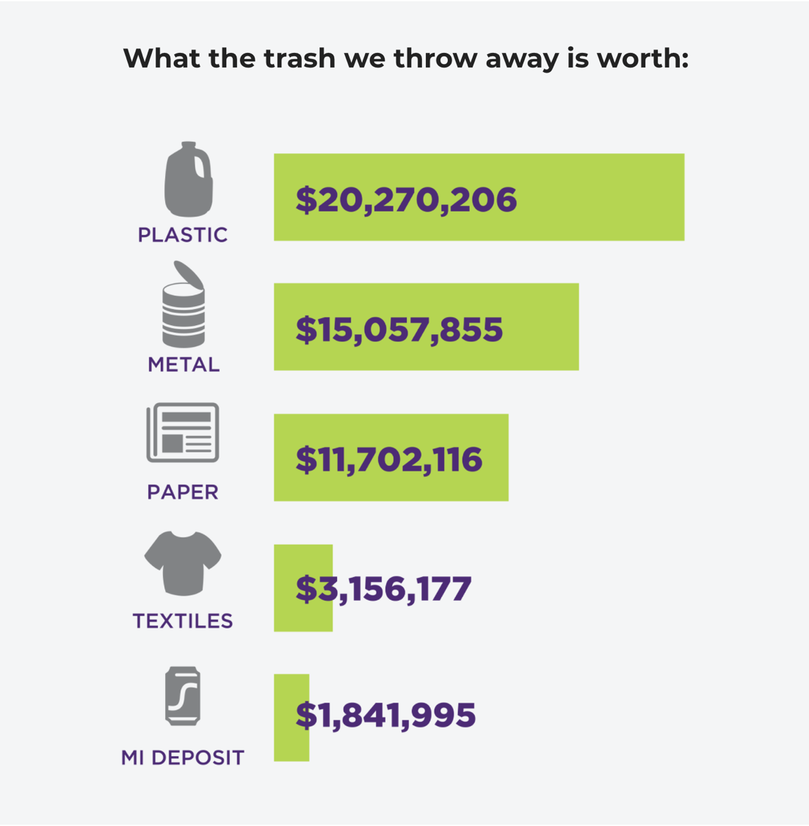
SOURCE: Kent County, reimagetrash.org
Notes:
Kent County website
http://www.reimaginetrash.org/

Slide 4
Materials Management Planning Overview
INVENTORY & IDENTIFY BASELINE
Where you are
➤ Identify deficiencies
➤ Goals to accomplish your vision
CREATE GOALS
Where you want to go
➤ Possible goals to fix deficiencies
ESTABLISH IMPLEMENTATION STRATEGY
How to get there
➤ Develop mechanisms to achieve goals
MOVE MATERIALS MANAGEMENT FORWARD
Success
➤ Achieve goals
Notes:
MM > focus on managing our organics and recyclable materials better
MMP will help to create the vision for each Planning Area
Develop facilities and systems to increase the diversion of these materials
Michigan’s goals > 45% & make it as easy to recycle as it is to dispose of materials in a landfill

Slide 5
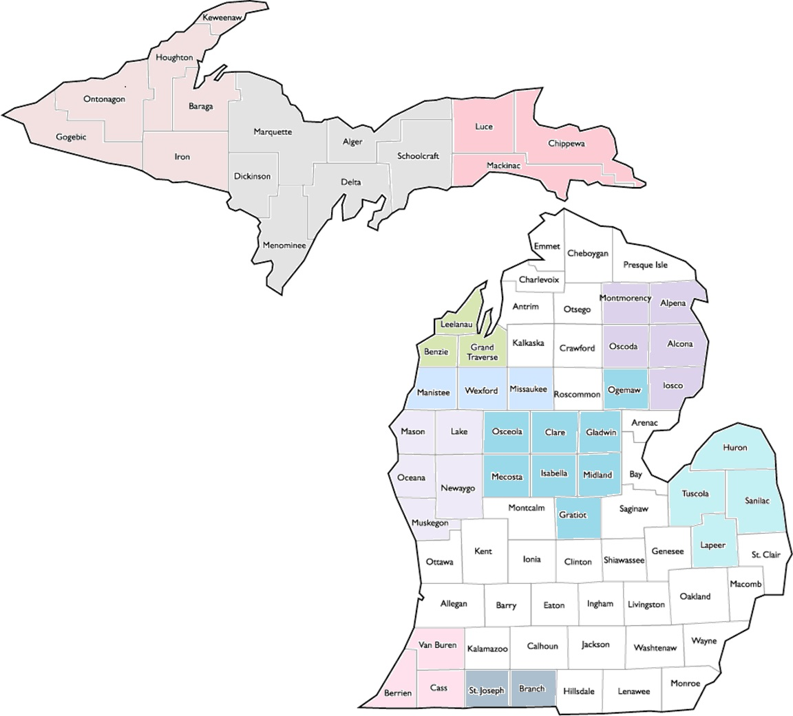
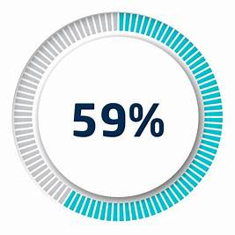
MMP Development (Based on Notice of Intent (NOI) correspondences)
Multicounty MMPs Counties
WUPPDR: Baraga, Gogebic, Houghton, Iron, Keweenaw, Ontonagon | CUPPAD: Alger, Delta, Dickinson, Marquette, Menominee, Schoolcraft
EUP: Chippewa, Luce, Mackinac | Benzie, Grand Traverse, Leelanau
Manistee, Missaukee, Wexford | WMSRDC: Lake, Mason, Muskegon, Newaygo, Oceana
Hartland: Clare, Gladwin, Gratiot, Isabella, Mecosta, Midland, Ogemaw, and Osceola. | Thumb Region: Huron, Lapeer, Sanilac, Tuscola
SWMPC: Berrien, Cass, Van Buren | Branch, St. Joseph
MOIAA: Alpena, Alcona, Iosco, Montmorency, Oscoda
Counties Developing a Multicounty MMP
Counties in white are pursuing the MMP as a single county or have received an extension for its NOI submittal.
NOTE: The following counties have been accepted for a NOI extension: Clare, Gladwin, Gratiot, Hillsdale, Huron, Isabella, Kalkaska, Lapeer, Mecosta, Midland, Ogemaw, Osceola, Sanilac, Tuscola, and Wayne.
NOTE: Bolded counties equals single county.
Notes:
49 counties collaborating of the 83 = 59%
Last round only 5 counties collaborated (2 groups) = 6%
The Materials Management County Engagement Grant (MMCE) helped to drive collaboration among counties encouraging them to pursue a multicounty MMP as they had also jointly completed the MMCE grant.
Planning staff outreach and engagement also helped to drive collaboration: workgroup meetings, presentations, MRC regional, webinars, etc.
To-date EGLE will not need to prepare a MMP for any county. [Previous round the Department prepared 5 county plans because they declined preparation.]

Slide 6
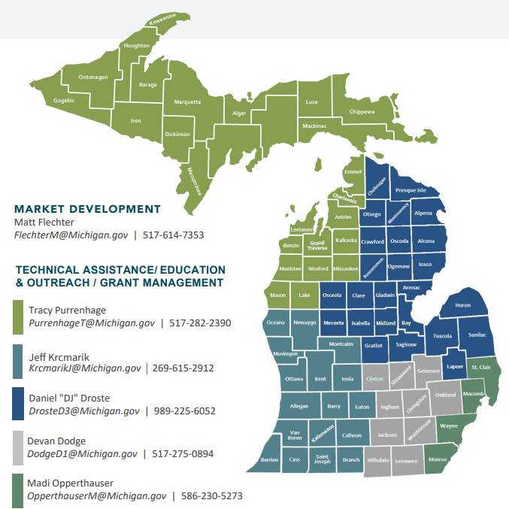
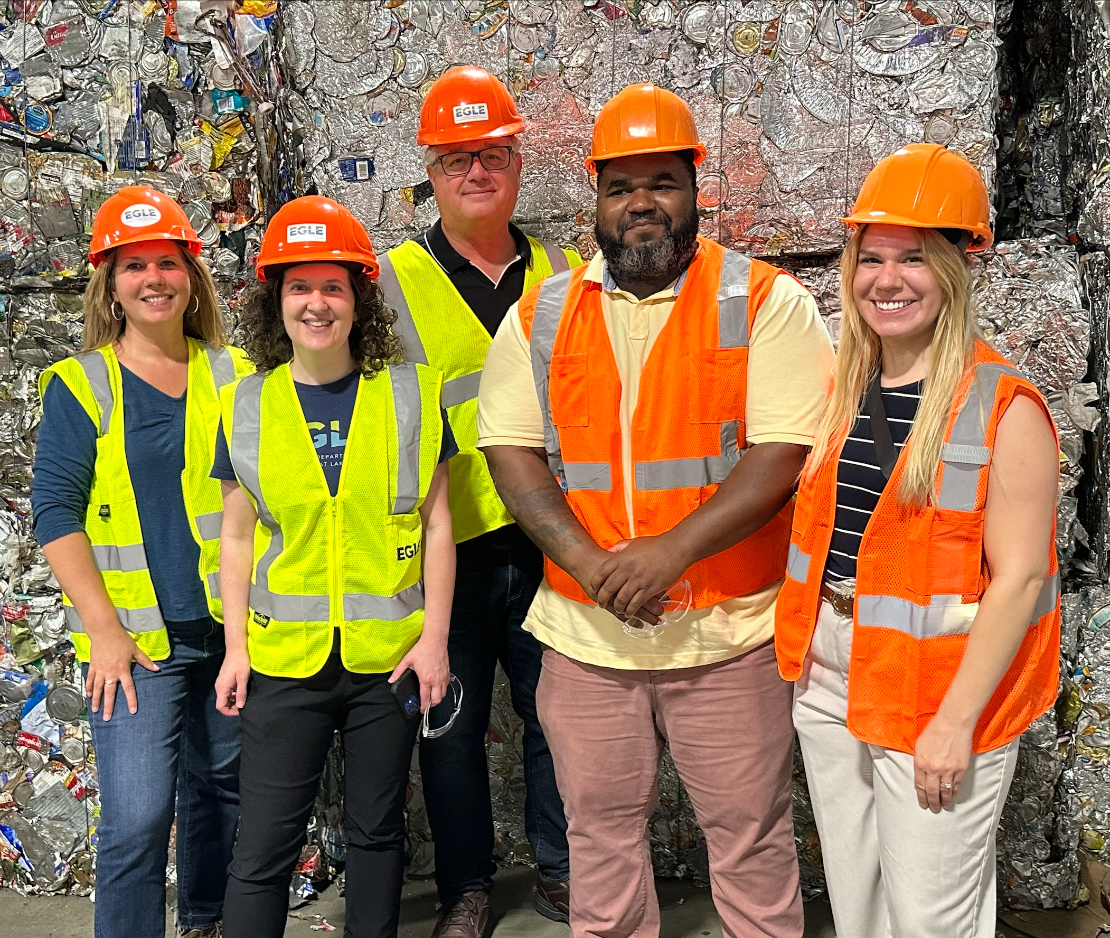
CONTACT YOUR
RECYCLING SPECIALIST

Slide 7
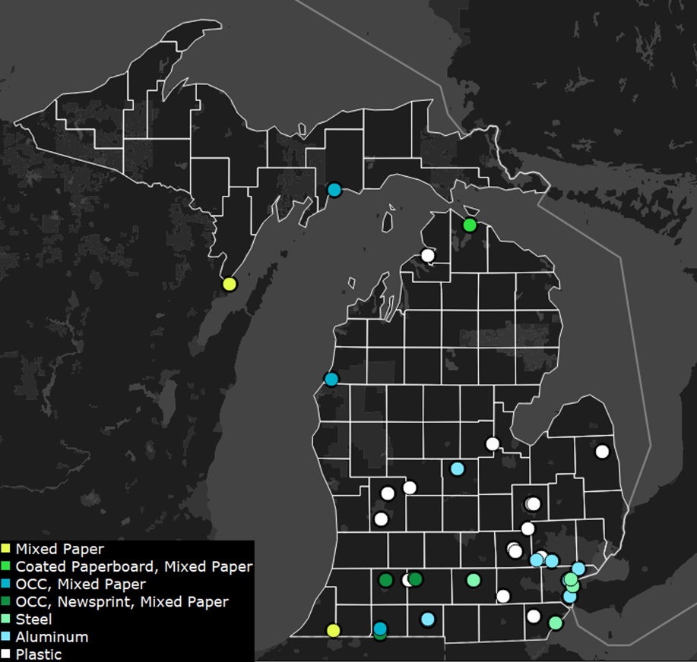
Michigan End Markets
Michigan does not have any glass cullet plants or aluminum UBC plants
Data Source: RRS Database
Refer to interactive map: https://www.nextcyclemichigan.com/end-markets-base-map
Notes:
Michigan has end markets for plastics, mixed paper and corrugated cardboard, and steel and lacks any end markets for aluminum and glass. Many markets for plastic are often geared towards post industrial or clean commercial streams with fewer capabilities around post-consumer plastics

Slide 8
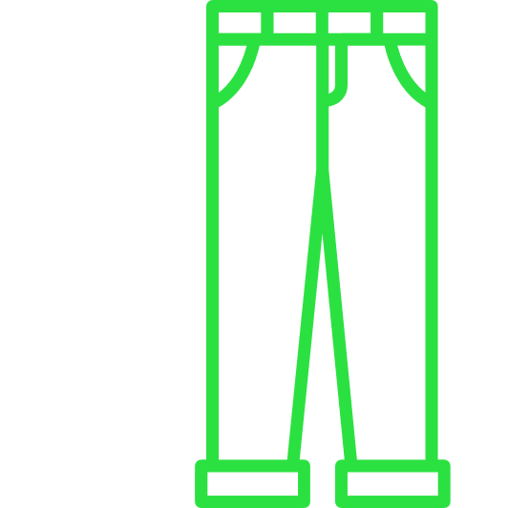
End markets
FEEDSTOCK
NEW PRODUCT
Building end market demand is key to reaching 45% recovery.
Notes:
So I think we all know that building end markets is key to reaching 45% recovery. Once materials are collected and processed, we need end markets to receive these materials as a critical link in the circular economy supply. Growing end market demand –is critical to successful and sustainable recovery. Examples include: textiles - which are a fast growing sector of the waste stream (rep 6-10% of waste stream) , and can be upcycled to new products or processed for the natural or synthetic fibers for uses such as insulation and padding. Film plastic and flexibles can be made itto composite lumber, and mixed plastics in general need additional end market opportunities to increase recovery. Organics recovery represents opportunities in many sectors, including road-building, erosion control, feedstock for regenerative agriculture, and water retention GLASS can be used as a feedstock for new containers, concrete, fiberglass insulation and industrial fillers. Yet we have no glass end markets in our state.
he biggest end market gaps, representing priority areas for growth and investment to reach a 45% recovery rate, were the following:
ORGANICS (yard waste, food waste, food processing residuals, etc.) as feedstocks for regenerative agriculture, water retention and similar eco-system services, etc.
RECOVERED PACKAGING cardboard and pizza boxes as part of a circular food and product transportation system.
PLASTIC PACKAGING as a source of polymer feedstocks for new packaging, products and fuels. 'flexibles' Mixed Plastics and Plastic Films!
GLASS as a feedstock for new containers, concrete, fiberglass insulation and industrial fillers.
HARD-TO-RECYCLE MATERIALS such as textiles and carpets, batteries including car and electronics lithium charging systems, mattresses, paints, and more that need better end-markets and would benefit from investment to provide innovative solutions for recovery. One priority to highlight is addressing Textiles: textile waste is growing faster than any other material in the US waste stream. Represents 6-10% of waste stream. (2020 US $4B to collect and dispose textiles, only 15% recovered today)
Link to tracks here?

Slide 9
Calculating Recycling Rate
(Total tons MSW recycled and composted, divided by the total tons MSW recycled, composted, landfilled, incinerated) x 100 = Recycling RatE

Slide 10
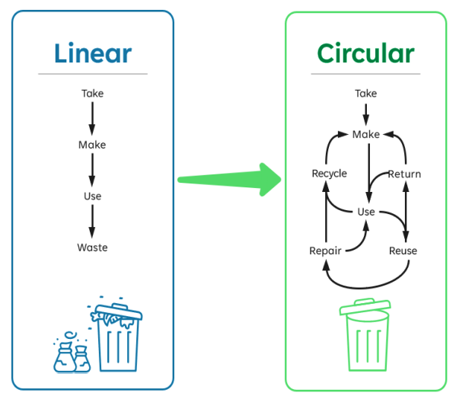
2023 Gap Analysis
nextcyclemichigan.com/resource-library

Slide 11
Notes:
The Benchmark Recycling Standards are intended to be a minimal and achievable level of access to residential recycling opportunities, as we work toward 1. a statewide recycling rate of 45% and 2. work toward a day when all Michigan residents are able to recycle materials as easily as they can dispose of them in a landfill. Our goal is equitable recycling access.
2026 – 90% of single-family dwellings in urbanized areas have access to curbside recycling
2028 – 90% of single-family dwellings in areas with >5,000 residents have access to curbside recycling
2032 – In counties with a population <100,000 residents: there is at least 1 drop-off location for every 10,000 residents without access to curbside recycling at their dwelling and the drop-off location is available at least 24 hours per month.
2032 - In counties with a population >100,000 residents: there is at least 1 drop-off location for every 50,000 residents without access to curbside recycling at their dwelling and the drop-off location is available at least 24 hours per month.

Slide 12
Organics (Food Waste) Grant
$ for food waste related infrastructure items ( "things")
Metrics = New or expanded food waste diversion programs
Reimbursement grant; Minimum 20% cash match
Open to both public and private sectors
This does NOT pay for Part 115 compliance
michigan.gov/egle/about/organization/materials-management/recycling

Slide 13
Recycling Infrastructure Grant
$ for recycling related infrastructure items ( "things").
Reimbursement grant; Minimum 20% cash match.
Hot Tip: Have grant ideas in mind before RFPs get released. Also, RFP only open to public sector.
This is a funding opportunity, not a funding mechanism.
Metrics = Change/Expansion/Growth
Increase tons diverted
New sectors (residential, commercial)
New materials collected
michigan.gov/egle/about/organization/materials-management/recycling

Slide 14
Public Sector Funding Mechanisms
Landfill Surcharge
PA 69
PA 185
Voter Approved Millage
PA 138
Hauler License Resource Recovery Fee
Community Host Agreement
Regional Authority
Notes:
Voter Approved Millage
PA 138 – Up to $25/hh/yr surcharge by vote of local units, county board
PA 69 - Up to $50/hh and business fee - by vote of local units, county board
PA 185 - by establishment of board of public works – assessments, fees, bonds
Landfill Surcharge (or Transfer station) – by ordinance and contracts at in or out-of-county landfill
Hauler License Resource Recovery Fee
Authority as organizational structure, within which various funding mechanisms can be deployed

Slide 15
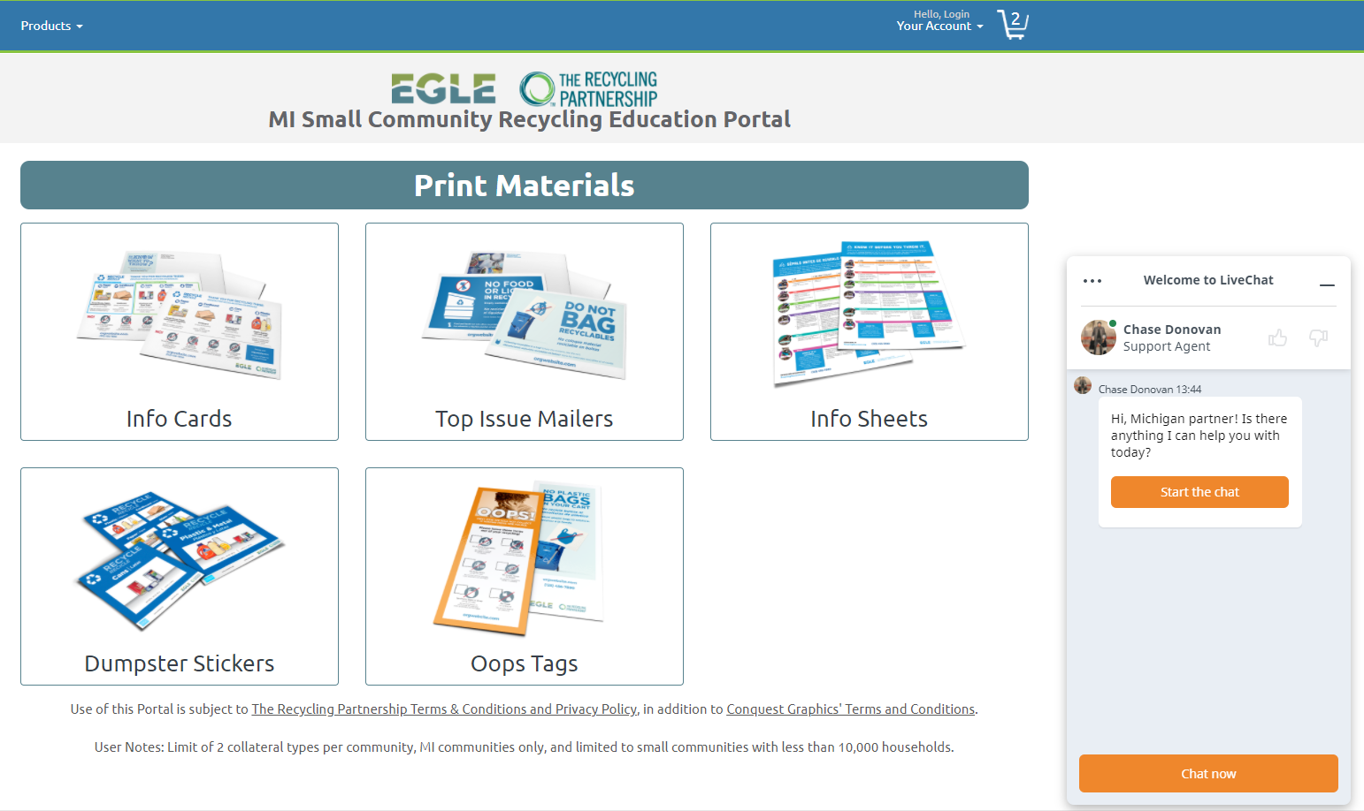
Small Community Education Grant Portal
For communities under 10,000 households (approx. 30,000 pop)
Provide customizable collateral design/printing/mailing
Info Cards
Top Issue Mailers
Info Sheets
Drop Off Signage
Cart Tags
No upfront costs, no match
Choose 2

Slide 16
Recycling Partnership Residential Curbside Cart Grants
Grants for cart-based curbside recycling systems
Funding up to $15/cart, depending on service type
Technical assistance and design of education/ outreach materials
RFP available on an on-going basis
Designed to align with State grants
https://recyclingpartnership.org/recycling-cart-grant/

Slide 17
Thank You!
Jeff Krcmarik
krcmarikj@michigan.gov
269-615-2912

